Slide 1

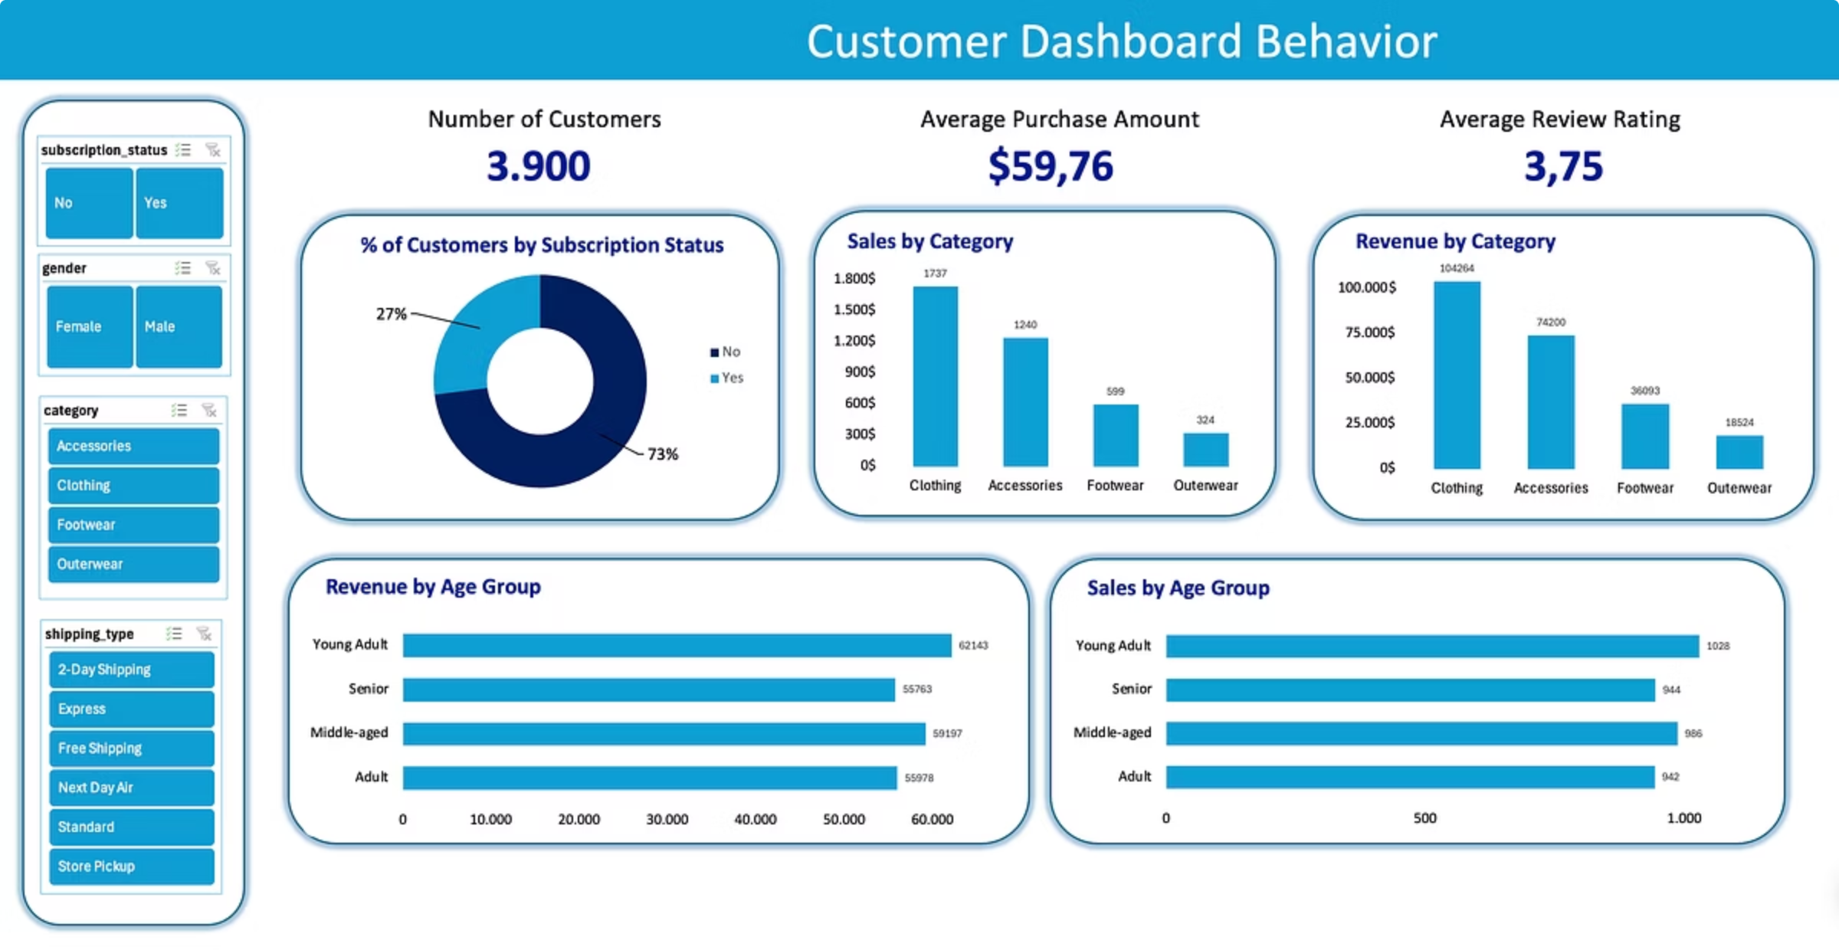
Customer Shopping Behavior Analysis
Work made by Leyla Gahramanova

Slide 2

Data Preparation Process
1
2
Load Data
Explore & Inspect
Import dataset
Check structure
3
4
Clean & Standardize
Engineer & Export
Handle missing values
Create features

Slide 3

Dataset Overview
3,900
Total Purchases
18
Data Columns
37
Missing Values
Only in Review Rating column
Comprehensive transaction data
Customer demographics & behavior

Slide 4

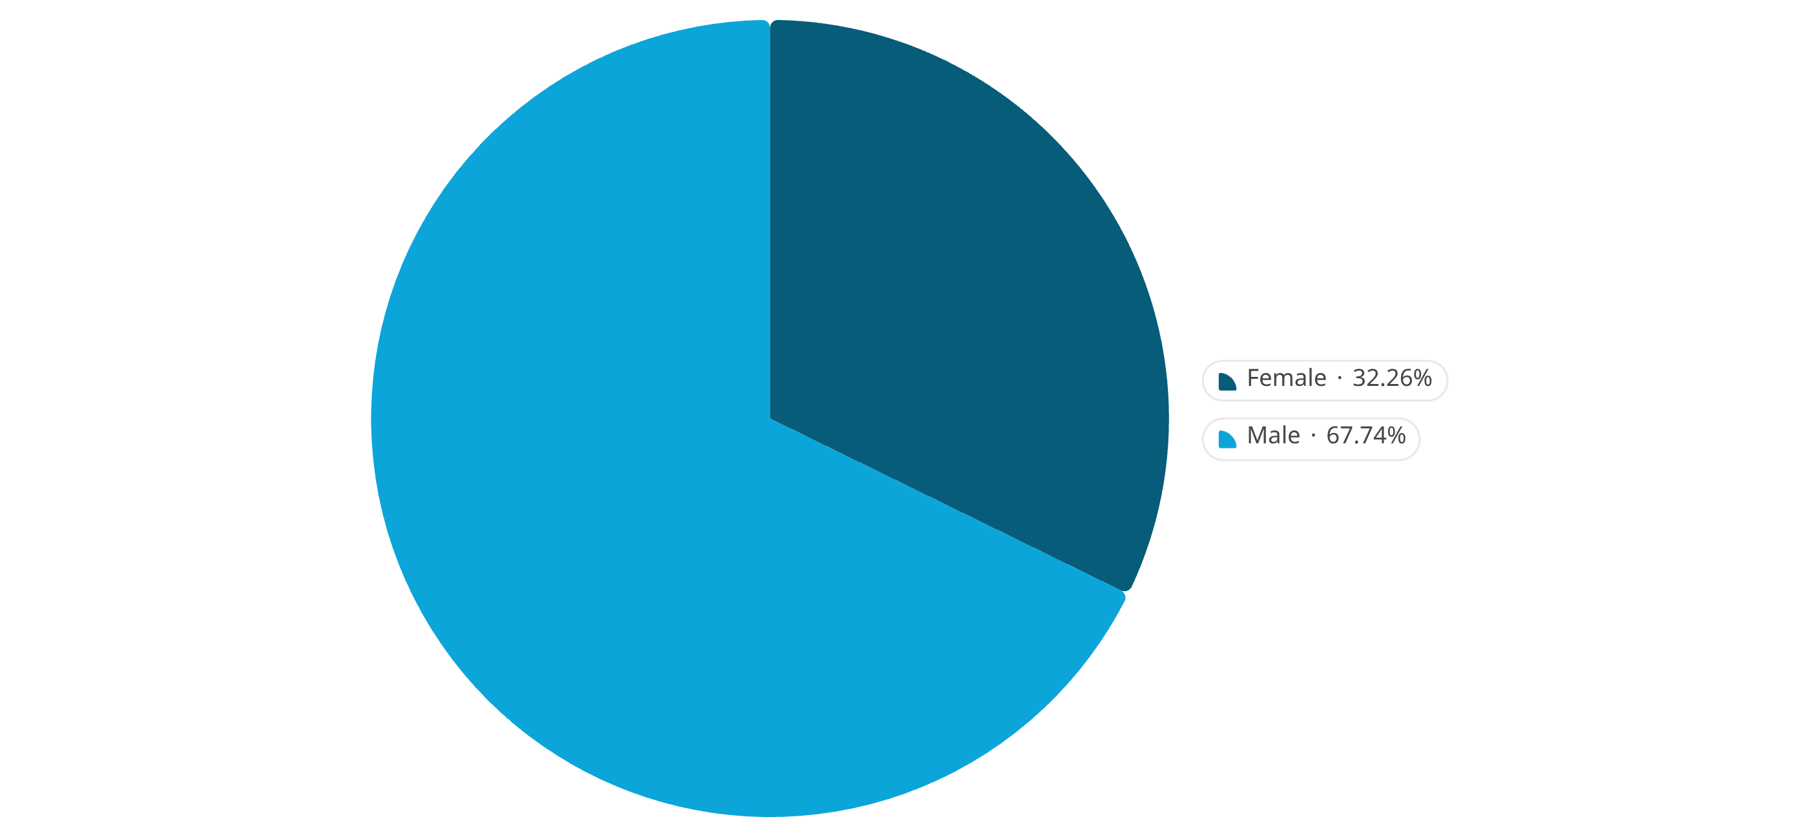
Revenue by Gender Analysis
Gender-based marketing strategies could optimize revenue streams
Male customers generate slightly higher total revenue than male customers

Slide 5










Top 5 Products by Rating
Found products with the highest average review ratings.
Boots
Sandals
3.82
Hat
3.84
3.80
Gloves
Skirt
3.86
3.78

Slide 6













Top Products by Order Volume
Clothing & Accessories lead in order volume
Blouse
Pants
Shirt
Jewelry
171 orders
171 orders
169 orders
171 orders
Sunglasses
Belt
Jacket
Coat
161 orders
161 orders
163 orders
161 orders
Sandals
Shoes
Sneakers
160 orders
150 orders
145 orders

Slide 7

High-Value Discount Users
Customers using discounts while spending above average
839 customers identified
Average spending: $80.15

Slide 8



Subscription Impact
7.4%
27%
65%
Higher Spend
Revenue Share
Loyalty Rate
Average spend difference between subscribers ($62.45 avg) and non-subscribers ($58.12 avg)
From subscription customers
Repeat purchase rate

Slide 9

Shipping Preferences Impact
Compared average purchase amounts between Standard and Express shipping.

Slide 10
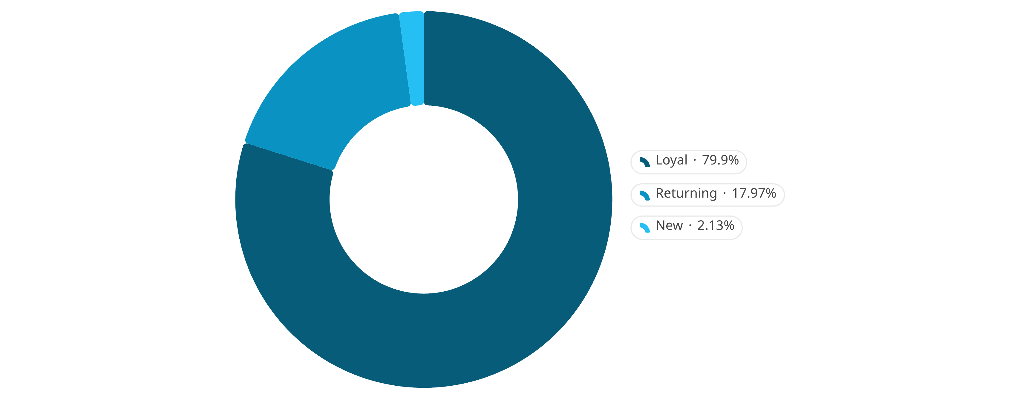
Customer Segmentation
Loyal 80% | Returning 18% | New 2%

Slide 11



Key Metrics Summary
Total Revenue
Average Purchase
Total Customers
$233,081
$59.76
3,900
Top Product Category
Clothing & Accessories

Slide 12
Customer Insights
80%
2.1×
High-value discount users are prime targets
of customers are loyal
Male customers spend more

Slide 13




Strategic Recommendations
Reward high-value shoppers
Focus premium offers on men
Drive express shipping
Push top-rated products

Slide 14
Thanks for watching
Leyla Gahramanova

